Slide 1
Algebra 4
Day 72

Slide 2
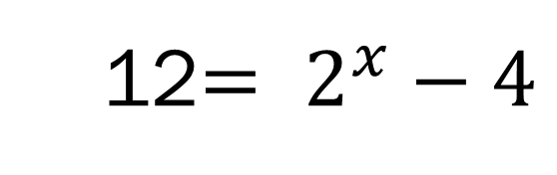
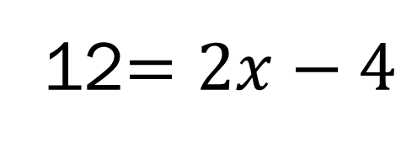
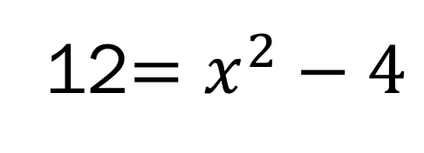
Bell Work: How would you solve the following?
12$=2x−4$
12$=x^{2}−4$
12$= 2^{x}−4$

Slide 3
7.1 Exploring Exponential Models 7.2 Properties of Exponential Functions
Objectives:
Model Exponential Growth and Decay
Evaluate exponential functions with base a (and base e)

Slide 4
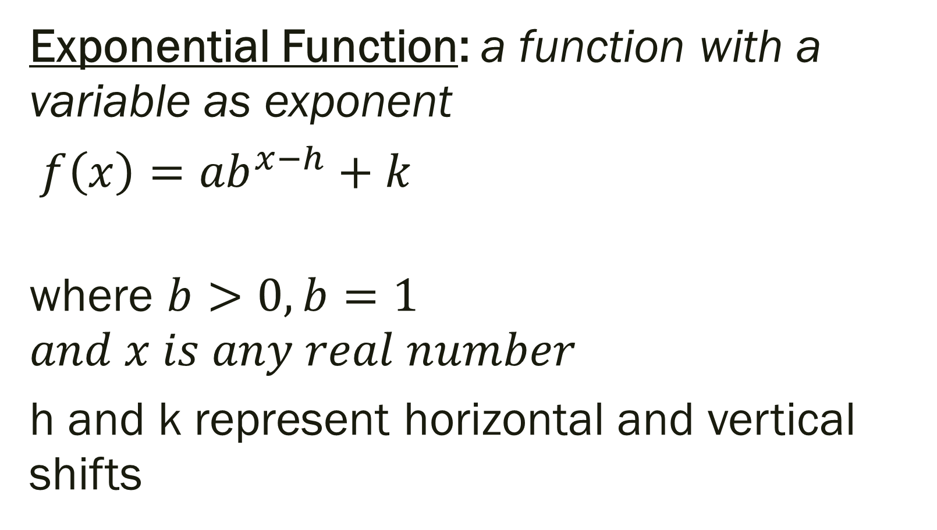
Exponential and Logarithmic Functions
Exponential Function: a function with a variable as exponent
$f\left(x\right)={ab}^{x−h}+k$
where $b>0, b=1$ $$and x is any real number$$
h and k represent horizontal and vertical shifts

Slide 5

7.1 Exploring Exponential Models Objective: Model Exponential Growth and Decay
$$y={ab}^{x}$$
If a > 0 and b > 1, the function represents exponential growth
If a > 0 and 0 < b < 1, the function represents exponential decay

Slide 6
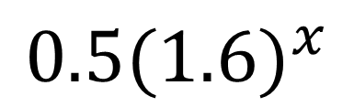
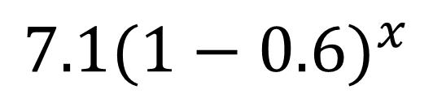
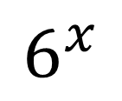
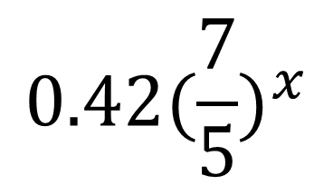
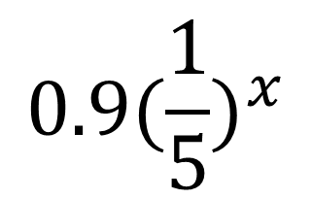
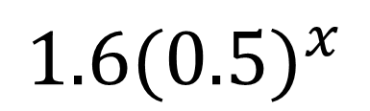
Growth or Decay
$$0.5(1.6)^{x}$$
$$1.6(0.5)^{x}$$
$${0.9(\frac{1}{5})}^{x}$$
$$6^{x}$$
$${0.42(\frac{7}{5})}^{x}$$
$$7.1{(1−0.6)}^{x}$$

Slide 7
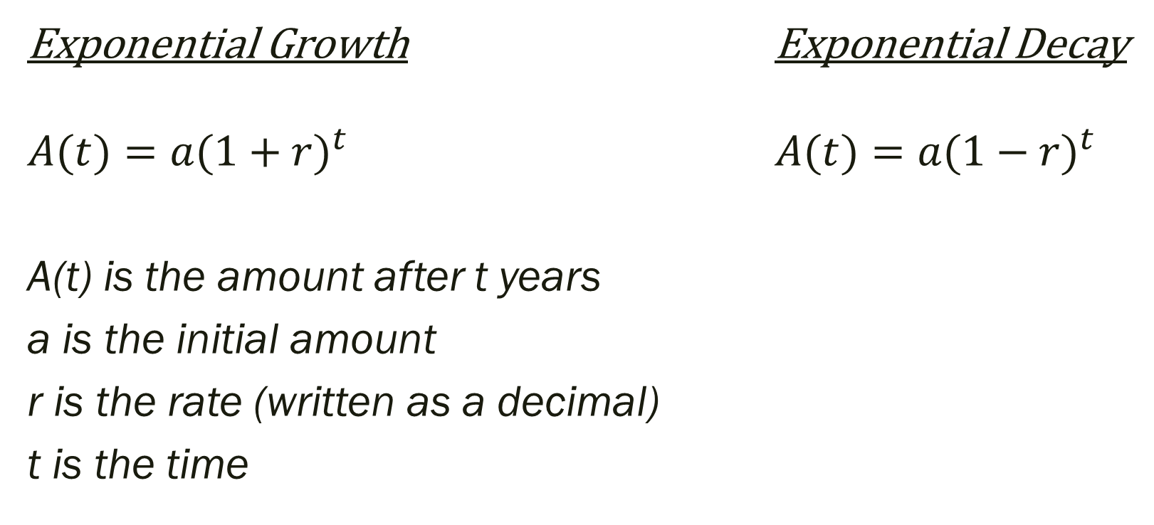
Exponential Growth and Decay Formula
Exponential Growth Exponential Decay
$A(t)={a(1+r)}^{t}$ $A(t)={a(1−r)}^{t}$
A(t) is the amount after t years
a is the initial amount
r is the rate (written as a decimal)
t is the time

Slide 8
Example: Write an exponential model and answer the question.
A population of 80,750 grows by 4.2% per year. What will the new population be after 12 years?
You have $4,500 in an account that decays by 8.54% per year. How much will be in the account after 7 years?

Slide 9

Example: Graph and determine if growth or decay
$$f\left(x\right)=0.2(4.6)^{x}$$
$$f\left(x\right)=4.1(0.6)^{x}$$

Slide 10
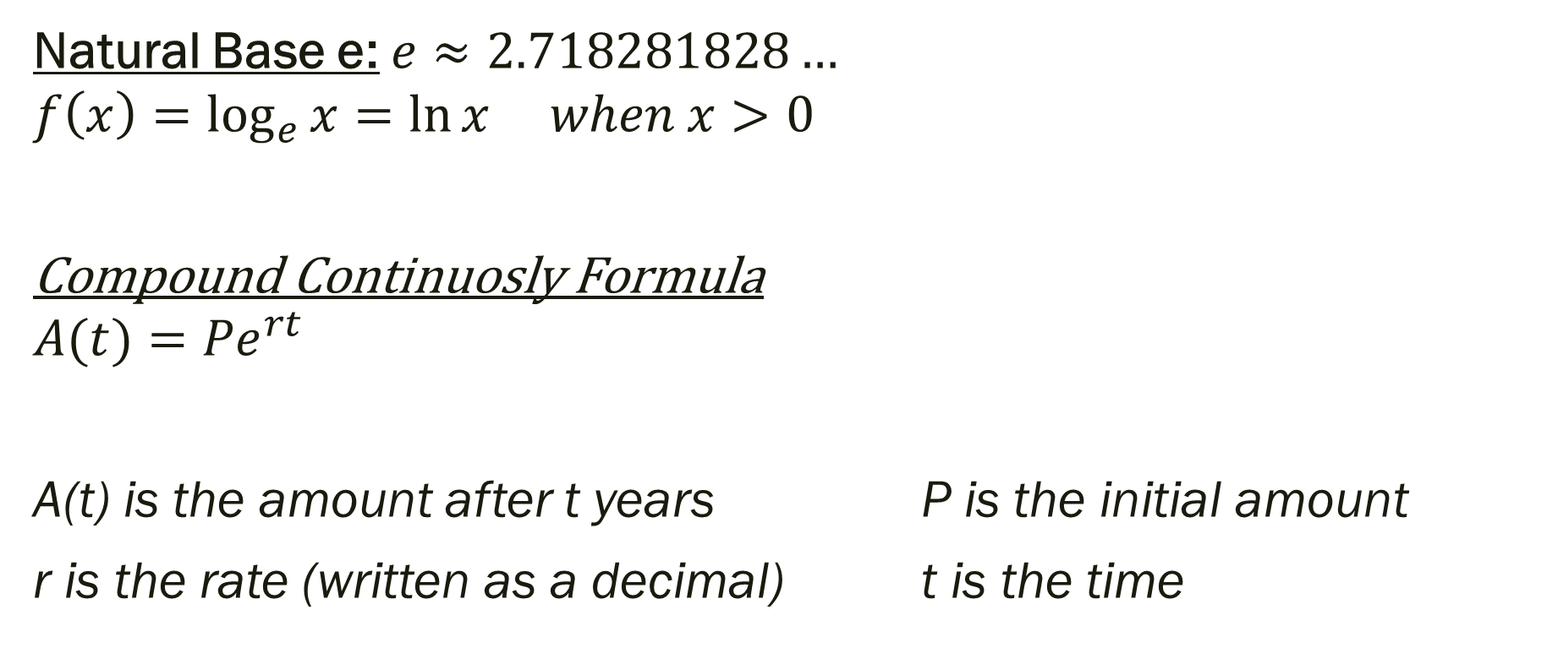
7.2 Properties of Exponential Functions Objective: Evaluate exponential functions with base a (and base e)
Natural Base e: $e≈2.718281828…$
$$f\left(x\right)=\log_{e}{x}=\ln{x when x>0}$$
Compound Continuosly Formula
$$A(t)={Pe}^{rt}$$
A(t) is the amount after t years P is the initial amount
r is the rate (written as a decimal) t is the time

Slide 11
Example: Solve
A population of 120,750 grows continuously at 5.3%. What will the new population be after 6 years?

Slide 12
For Next Time…
Page 439 # 1, 3, 5, 7, 8, 26
Page 447 # 17, 19, 29, 32

